Slide 1
Course : 0553T / Multimedia System
Year : 2015
VIDEO
Session 06

Slide 2
OUTLINE
Introduction
Analogue Video
Digital Video
Digital Video Containers
Shooting and Editing Video
Guidelines for Video

Slide 3



Introduction

Slide 4
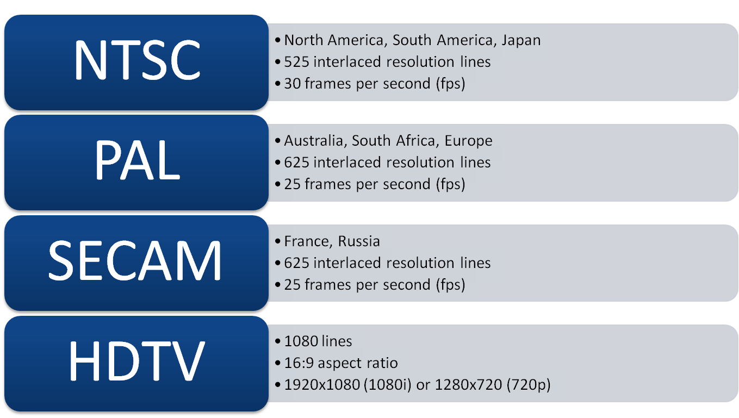
INTRODUCTION
Common standard Broadcast Video

Slide 5
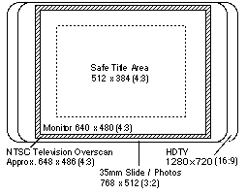
Introduction
The difference between VGA and HDTV aspects ratios

Slide 6
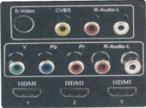
Analogue Video
In analog system, the output of the CCD (Charge-Coupled Device) is processed by the camera into three channels of color information and synchronization pulses (sync) and the signals are recorded onto magnetic tape.
CCD Output

Slide 7
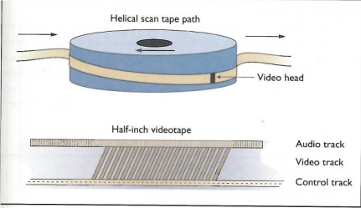
Analogue Video
As illustrated in Figure 6.1, each stripe represents information for one field of a video frame.
Figure 6.1

Slide 8
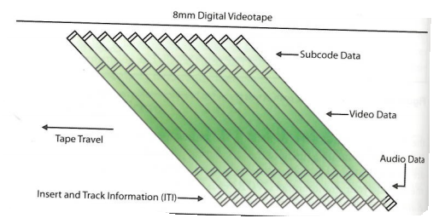
Digital Video
In Digital systems, the output of the CCD is digitized by the camera into a sequence of single frames and the video and audio data are compressed before being written to a tape.

Slide 9
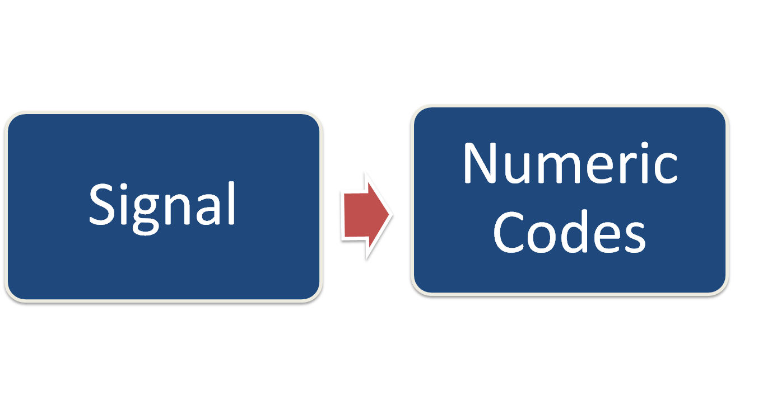
DIGITAL VIDEO
Digitisation

Slide 10
DIGITAL VIDEO
The quality of digital video depends on :
  Screen Resolution
    The number of horizontal and vertical pixels used to present the video image
  Frame Rate
    The number of individual video frames displayed per second
  Compression Method (codec)
    The particular algorithm used to compress and then decompress the digital video

Slide 11
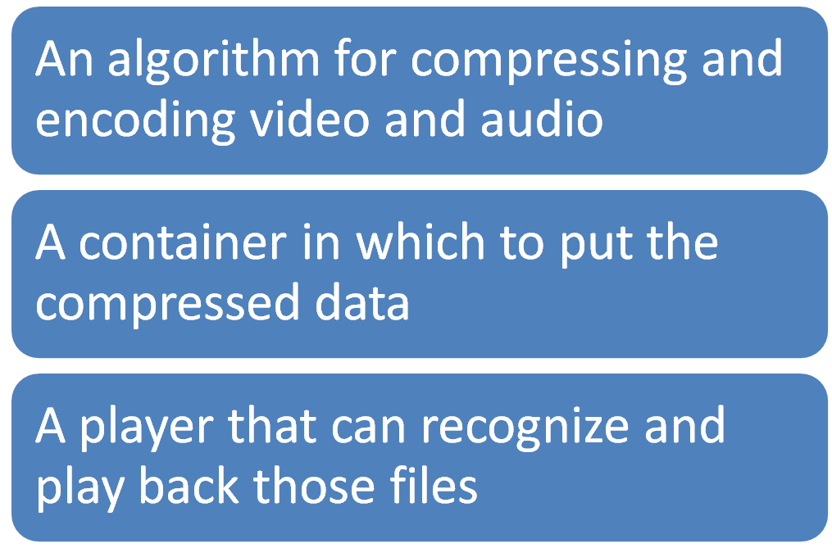
Digital Video Containers
A digital video architecture is made up of :

Slide 12
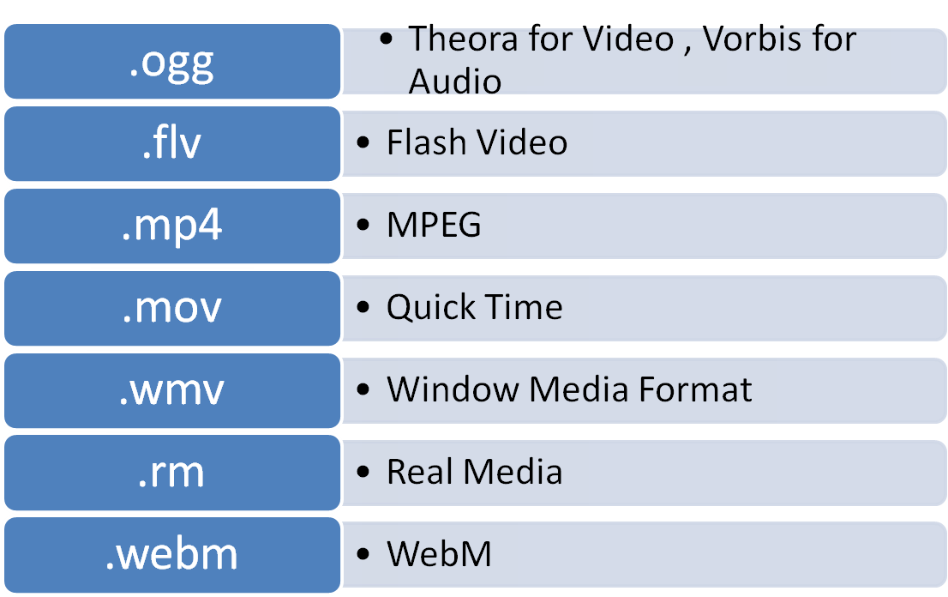
Digital Video Containers
Common containers for Video :

Slide 13
Digital Video Containers
Codecs ( Coder / Decoder) :
  Digital Video Compression Schemes
  The algorithm used to compress a video for delivery and then decode it in real time for fast playback
  Different codec are optimized for different method of delivery ( for example : from a hard drive, from a DVD, or over the WEB)

Slide 14
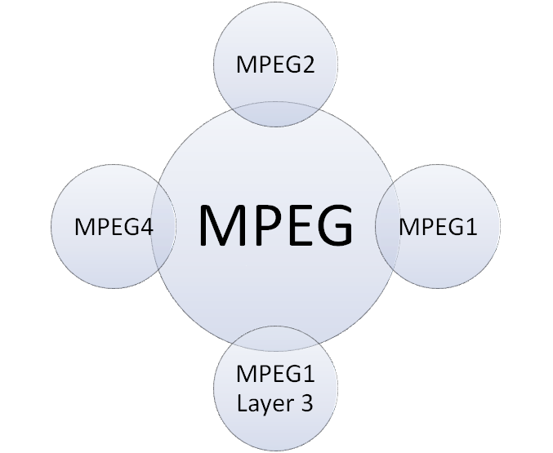
Digital Video Containers
MPEG ( Moving Picture Experts Group) :
  Standard for digital representation of moving pictures as well as associated audio and other data.

Slide 15
Shooting and
Editing Video
Shoot and Edit Video for use in Multimedia
  Always shoot using a steady shooting platform
  Storyboards are a useful exercise when planning a shoot
  Good, even lighting is extremely important
  Expensive stages are not required when using blue screen or Ultimatte techniques

Slide 16
Shooting and
Editing Video
Shoot and Edit Video for use in Multimedia (continue)
  Avoid wide panoramic shots and camera motion when shooting for a small computer window on CD-ROM or the Web
  Fonts for titles should be plain, sans serif and bold enough to easily read
  Editing using Non Linear Editing (NLE) software such as Avid Media Composer, Adobe Premiere, and Apple Final Cut

Slide 17
Guidelines for Video
The basic guidelines for Shooting :
  Choose a camera carefully.
    Consider : ex CCDs, Optics, Microphones,Storage Media,etc
  Use a tripod or lean against a solid surface
  White balance prior to shooting
    Especially important when changing between different lighting conditions
  Avoid shooting into light and backlit scenes
  Limit pans and zooms

Slide 18
Guidelines for Video
The basic guidelines for Shooting (Continue):
  Frame the subjects
  Make an inventory of required shots
    Different agles
    Wide shots, medium shots, and close-up
    Establishing shots, reverse angles,over the shoulder, and point of view shots.
  Use the highest resolution available
  Add external microphones if required
  Use headphones to monitor sound quality
  Record background sounds for use in editing
  Don’t break the time code

Slide 19
Guidelines for Video
Basic guidelines for Editing :
  Protect Source Video
    Keep copies of original sources
  Save a copy of the master video prior to rendering
Basic guidelines for Rendering
  Match codec, resolution, frame rate, and data rate to intended use and delivery medium
  Use variable bit rate encoding when available

Slide 20
SUPPORTING
MATERIAL
http://www.mpeg.org/
http://entertainment.howstuffworks.com/video-format.htm
http://www.maximintegrated.com/en/app-notes/index.mvp/id/1184

Slide 21
Exercise
Describe the architecture of digital video!
Discuss several consideration in shooting and editing video for multimedia!

